Slide 1
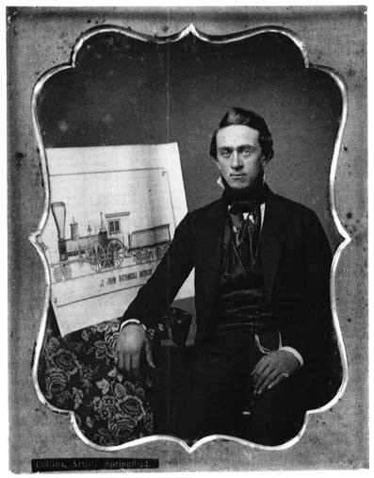
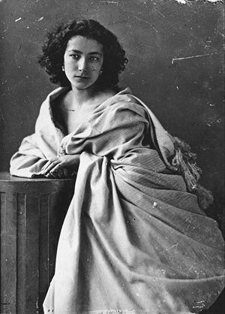
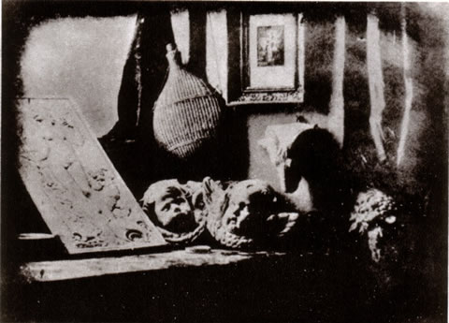
The History of Photography
“Writing with Light”

Slide 2
WHY USE PHOTOGRAPHY?
THE PRIMARY PURPOSE OF ART FOR CENTRURIES HAS BEEN THE RECORDING OF INFORMATION!
Art can tell a story
Art can capture a time period
Art can tell a personal history

Slide 3
The Camera

Slide 4
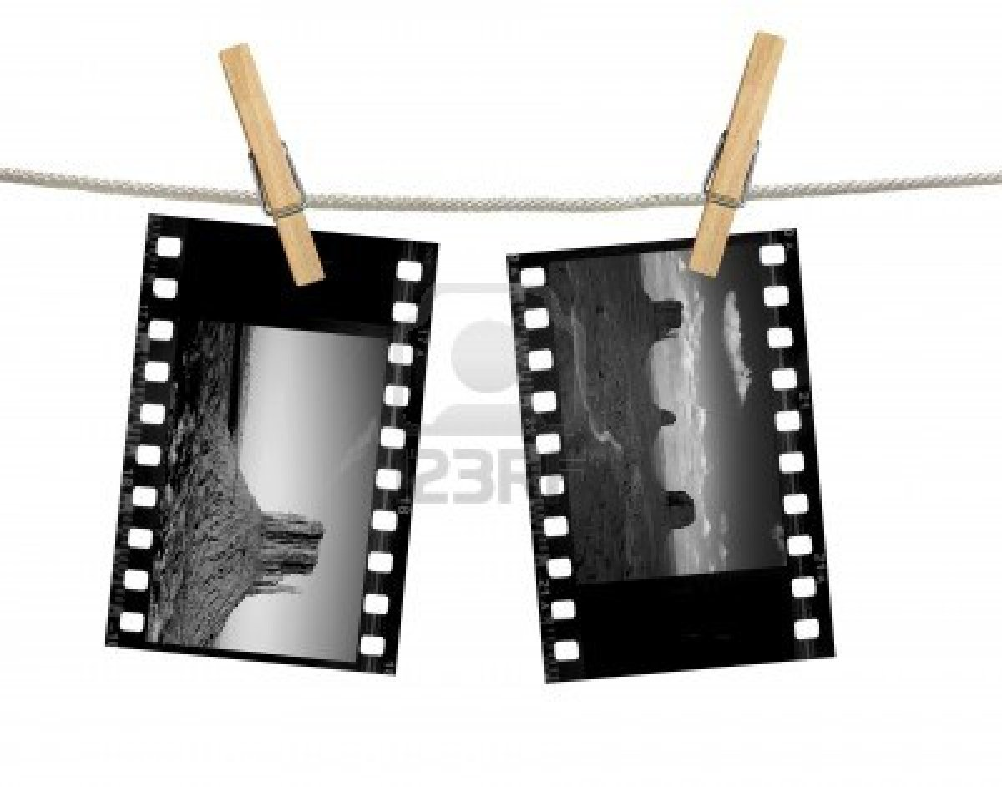
The Film

Slide 5
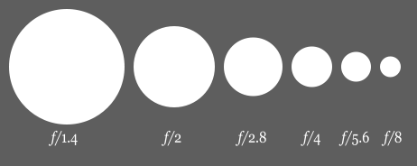
Aperture
Aperture: The size of the camera lens opening
Determines the AMOUNT of LIGHT that enters the camera
Larger APERTURES = More light exposing the film

Slide 6
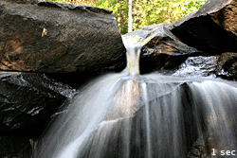
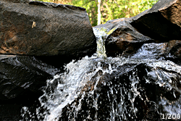
Shutter Speed
Shutter Speed: The length of time the shutter over the aperture is open
The FASTER the shutter speed, the CLEARER the picture

Slide 7
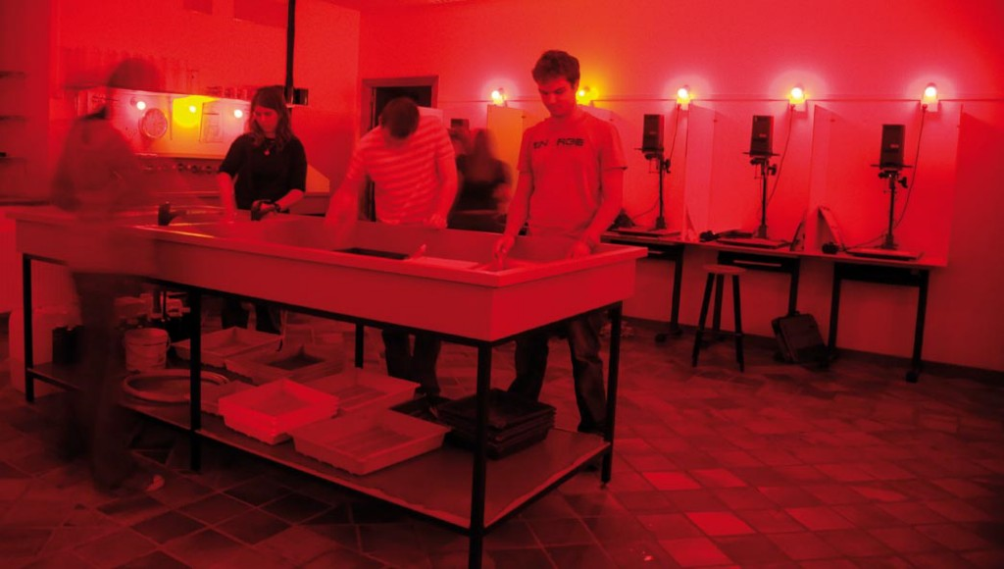
The Dark Room

Slide 8
Developing Film
<iframe width="560" height="315" src="//www.youtube.com/embed/nue495wxlXo" frameborder="0" allowfullscreen></iframe>

Slide 9
ADVANCEMENTS 1826 - 1900

Slide 10
THE FIRST PHOTOGRAPH - 1826
(40 years Before the Civil War in America)
WHO: Joseph Nicephore Niepce
WHAT: HELIOGRAPH: SUN DRAWING
DEVELOPING TIME: 8 hours
MATERIAL: Affixes the image using a PEWTER (metal) plate, covered with BITUMEN (asphalt) and lavender oil
PRO:
CON:

Slide 11
Joseph Nicephore Niepce View from the Window at Le Gras 1826

Slide 12
The Daguerreotype … mid 1830’s
WHO: Louis Jacques Mande Daguerre (business partner of Niepce)
WHAT: Daguerreotype
DEVELOPING TIME: ½ hour
MATERIAL:
Invention was an ACCIDENT! (The vapors from spilled MERCURY affix the image to the plate)
Image is made permanent by immersing it in a SALT based solution
PROCESS ONLY MAKES ONE COPY, The plate IS the COPY
PRO:
CON:

Slide 13
The Daguerreotype Camera

Slide 14
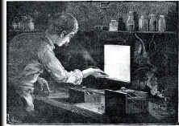
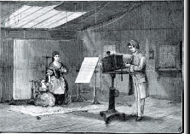
The Daguerreotype Process

Slide 15
Daguerre The Artists Studio 1837

Slide 16
Daguerre Boulevard du Temple 1838

Slide 17
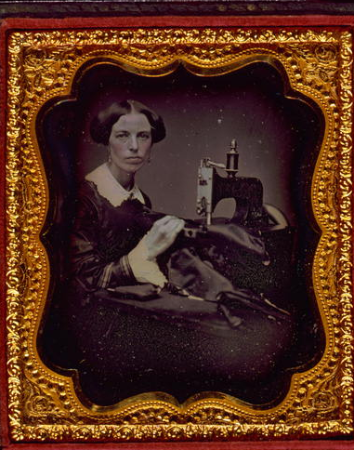
The Occupational Portrait – 1850’s

Slide 18
CALOTYPE - 1835
WHO: Henry Fox Talbot
WHAT: CALOTYPE: Greek for “beautiful impression”
DEVELOPING TIME: 1 HOUR
MATERIAL: Announces he can fix images on PAPER
PRO:
CON:
3 weeks after the public announcement of the dauguerreotype
Sets the standard for MODERN PHOTOGRAPHY!

Slide 19
Earliest Paper Negative
Talbot Window at Lacack Abby 1835

Slide 20
Talbot The Open Door 1835

Slide 21
PROBLEM!
How can you combine the SHARPNESS of the daguerreotype with the REPRODUCTABILITY of the calotype?????

Slide 22
Wet Collodian - 1851
WHO: Frederic Scott Archer
WHAT: Wet Collodian
DEVELOPING TIME: Development of the photos has to happen immediately after they are captured
MATERIAL: GLASS plate and a photographic EMULSION
Emulsion = light sensitive liquid
Glass must be kept WET
Watch Video: http://www.civilwarphotography.org/index.php/wet-plate-photography-a-demonstration

Slide 23
The Wet Collodion Portable Darkroom

Slide 24
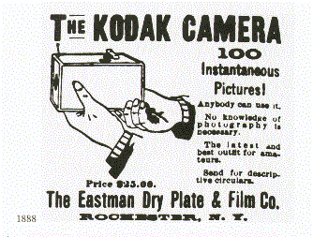
George Eastman and Kodak

Slide 25
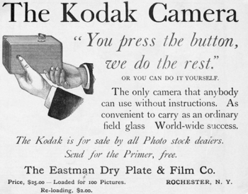
“You Press the Button, We Do the Rest”

Slide 26
The Kodak Camera - 1888
WHO: George Eastman
WHAT: The Kodak Camera (The Box Camera)
DEVELOPING TIME: Immediate
MATERIAL: ROLL FILM
PRO: Mass produce standard photography equipment,
Widely Available
Affordable
CON:

Slide 27
“George Eastman with a Kodak Camera” - 1890 Frederick Fargo Church

