Slide 1
American Impressionism
How did photography affect other art styles and movements?

Slide 2
Photography vs. Painting
Photography Benefits:
Allows for fascinating accounts of events
The camera can be used as an additional tool
Photography Threatens:
Artists livelihood ?
Threat to modern painting in general!?

Slide 3
Art is always a reaction to what has happened previously
Positive and/or negative reactions
Invention and ease of the camera changes the style of painting
We now go back and forth from the “real” and “not so real”

Slide 4
American Impressionism
“Impressionism” starts in Paris (1870’s)
Americans interpret this style
“Moments in Time”

Slide 5
Atmospheric affects of light
A painting that shows different times of day
Uses short brush strokes
Layer “opposite” or complimentary colors
Enhances the mood or feeling
Sometimes done “En Plein Air” = on the spot

Slide 6
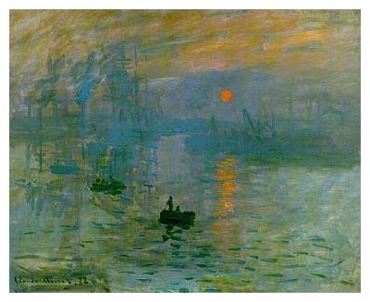

Slide 7
James Whistler
1834-1903
“art for arts sake”
If the photograph exists, why paint realistically?
SEE THE PAINT, SEE THE BRUSHSTROKES
Some titles have “music related names”

Slide 8
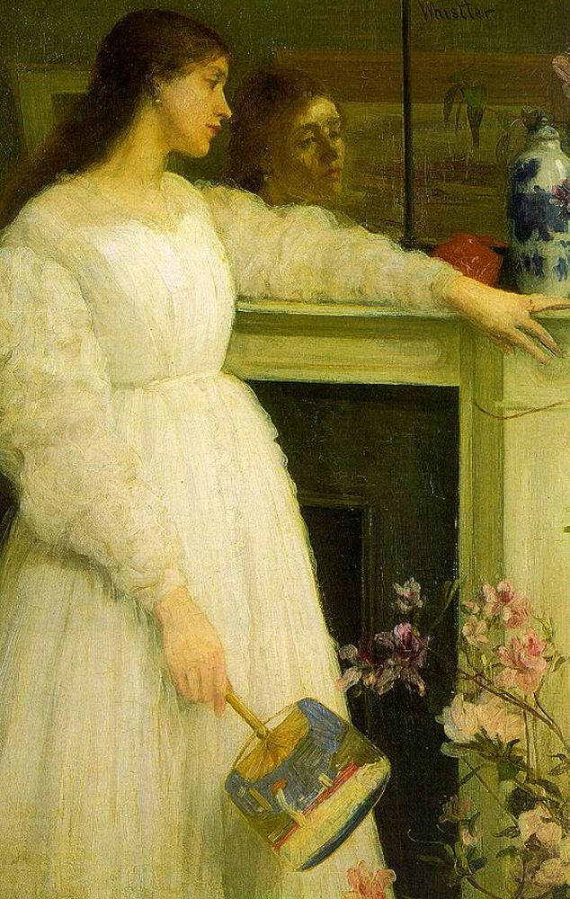
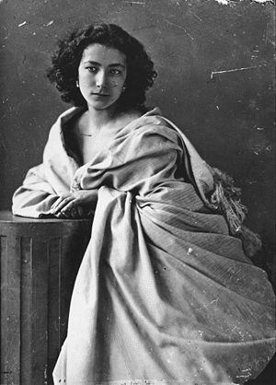
“Symphony in White” – Whistler, 1864 “Sarah Berndhart” – Sarony, 1864

Slide 9
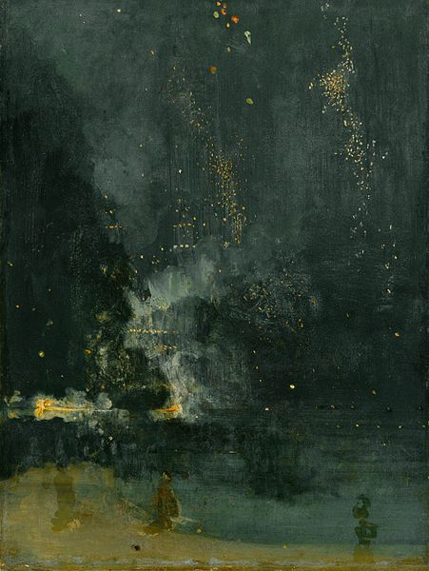
James Whistler
Nocturne in Black and Gold
Oil on Panel
1875

Slide 11
Mary Cassatt
1844-1926
Strong, independent woman
Leaves home for Paris at age 21 to study art
Influenced by European Impressionism
Painted private lives of women/children

Slide 12
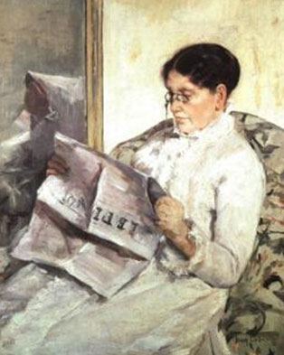
Mary Cassatt
Reading “Le Figaro”
Oil on Canvas
1878

Slide 13
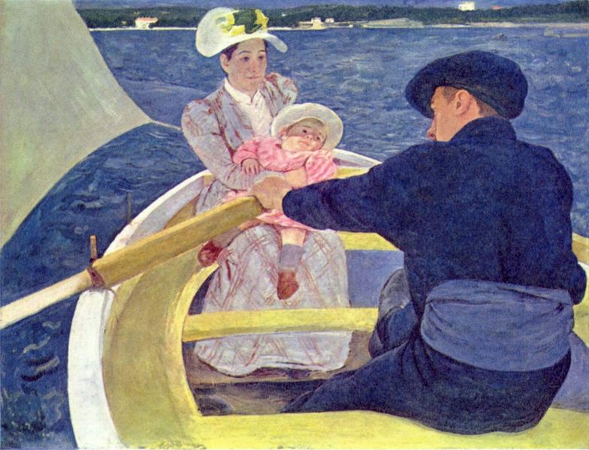
Mary Cassatt
The Boating Party
Oil on Canvas
1893-94

Slide 14
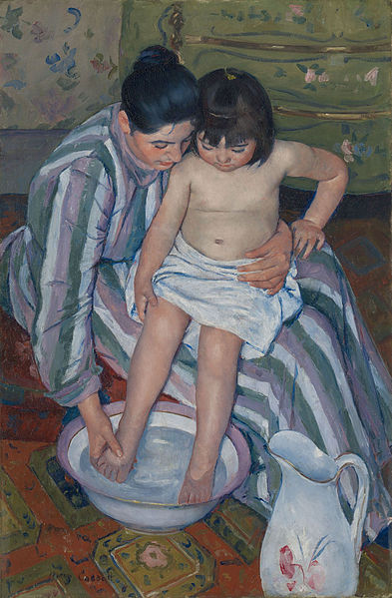
Mary Cassatt
The Childs Bath
Oil on Canvaas
1893

Slide 15
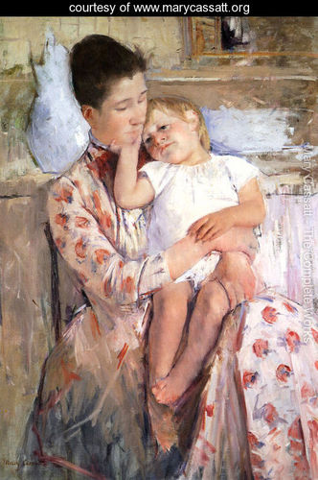
Mary Cassatt
Mother and Child XI
Oil on Canvaas
1897

Slide 17
THE TEN
10 painters who were the American equivalent of the major European Impressionists
Independently exhibited in NYC to gain public attention
Images show a new American cultural identity
Modern life should be depicted in a modern style

Slide 18
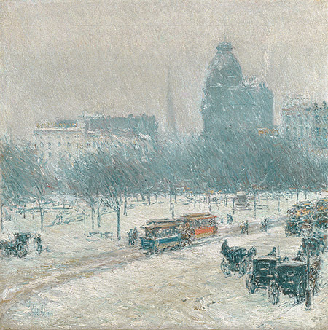
Childe Hassam
Winter in Union Square
Oil on Canvas
1889-90

Slide 19
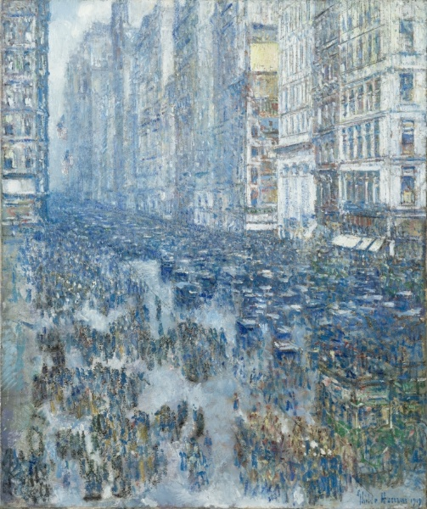
Fifth Avenue
Oil on Canvas
1919

Slide 20
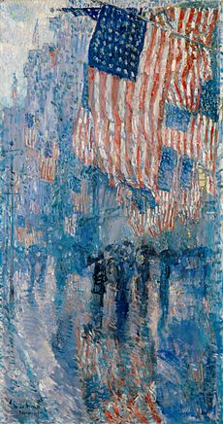
The Avenue in the Rain, oil on canvas, 1917.
The White House

Slide 21
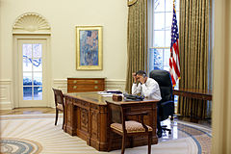

Slide 22
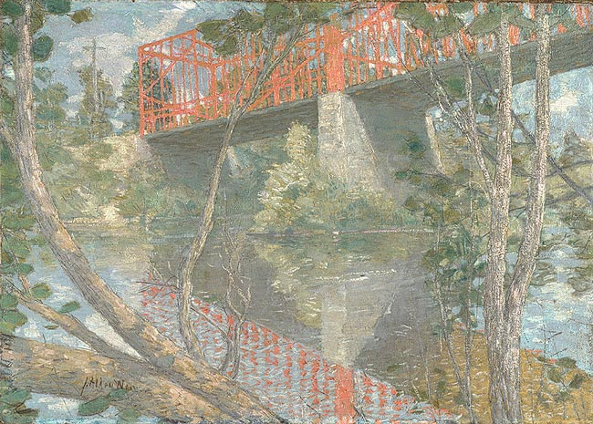
Julian Alden Weir
The Red Bridge
Oil on Canvas
1895

Slide 23
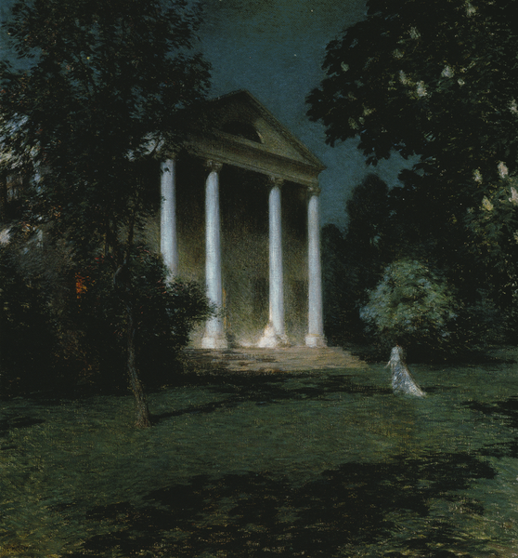
Willard Metcalf
May Night
Oil on Canvas
1906

Slide 24
Moving Forward
Artists will continually want to pursue the pragmatic face of America and the American experience
Artists are going to STOP looking to European ideals and traditions and start making their own DISTINCTLY AMERICAN ART!

Slide 25
American Realism
The face of America in the 20th century

Slide 26
Turn of the Century America
Industrialization & Consumerism
Urban lifestyles
Science and Technology
Education
Issues? Problems?
Notes:
1879 – Electricity
1893 – Auto assembly lines
1896 – x-ray
1903 – Wright brothers, gas powered airplane
1907 – Wizard of Oz is written
1908 – Model t sold!

Slide 27
Remember…
Artists want to pursue the pragmatic face of America and the American experience
Artists STOP looking to European ideals and traditions and start making their own DISTINCTLY AMERICAN ART!
Art builds on, and reacts to what happened previously

Slide 28
Realism
Honest depictions of the American experience
Uses more control of the paint
Snapshots in time
Used photography as a resource; did NOT paint en plein air

Slide 29
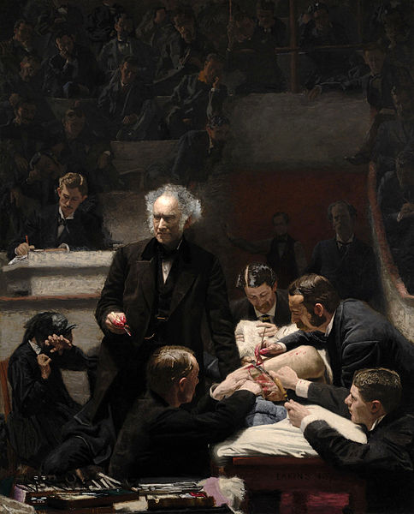
Realism
“moments in time”
No strong mood
Physical & intellectual toughness
Subjects: Real life situations, human form, science

Slide 30
Impressionism
Softer moments in time
Snapshots
Brushstrokes
Subjects: Women, domestic scenes, landscapes

Slide 31
Impressionism vs. Realism

Slide 32
Thomas Eakins
Father of American Realism
Paints scenes of American advancements in science and technology
Paints outdoor sports
Strong interest in the human figure
“Of course, it is well to go abroad and see the works of the masters, but Americans must strike out for themselves, and only by doing this will we create a great and distinctly American art.”

Slide 33
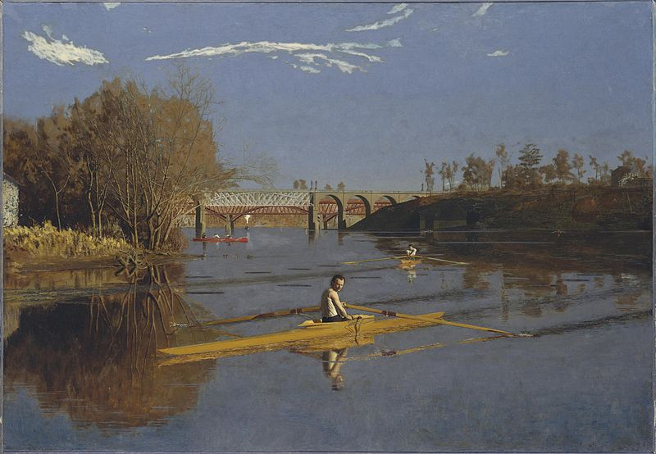
Thomas Eakins
Max Schmitt in a Single Skull
Oil on Canvas
1871
Notes:
Shocking to the artistic conventions of the city – contemporary sport
Painted outdoors + used photography as a tool
Introduces the camera to the American Art studio

Slide 34
Thomas Eakins
The Gross Clinic
Oil on Canvas
1875
Notes:
Fascinated by scientific developments
“too crudely realistic” – pushes the question “What is art”
Previously surgery meant AMPUTATION
Surgical Theatre
5 doctors
Mother shields her eyes
“Portrait of Dr. Samuel Gross” – calm, addressing an audience
One year to paint
8 feet tall by 6.5 feet wide
Where is the artist?
How does SCALE affect the overall viewpoint of the painting?

Slide 35
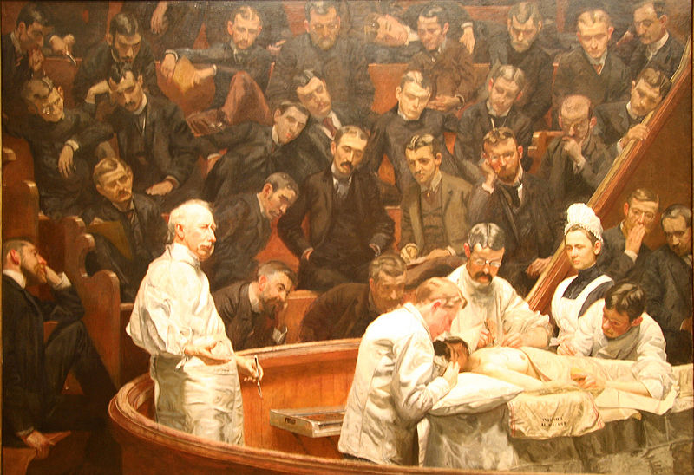
Thomas Eakins
The Agnew Clinic
Oil on Canvas
1889
Notes:
Woman receiving a mastectomy
Female nurse present
Audience of men
7 feet tall x 9 feet wide

Slide 36
SCALE
Relative size of one object to another

Slide 37
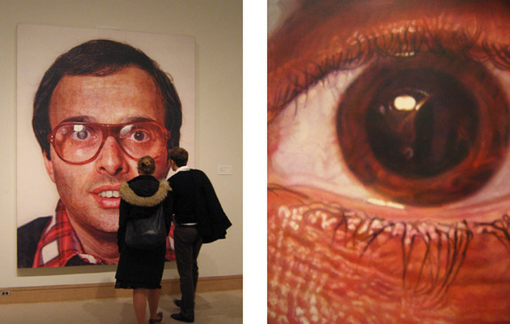
Notes:
Realism in an unreal scale

Slide 38
“The Eight” & “The Ashcan School”
THE ASHCAN SCHOOL = ART MOVEMENT
8 artists were excluded from the National Academy of Design’s annual exhibition
These artists put together their own show
Art should:
Depict ORDINARY PEOPLE (poor)
Address harsh realities of the modern world
Direct – not polished
Life is RAW

Slide 39
The Ashcan Artists
Notes:
No manifestos, didn’t really consider themselves a unified group
United by a desire to tell truths about city and modern life
Art is JOURNALISM!

Slide 40
John Sloan
1871-1951
Urban genre scenes
Wanted to be known for his skills, not his content!

Slide 41
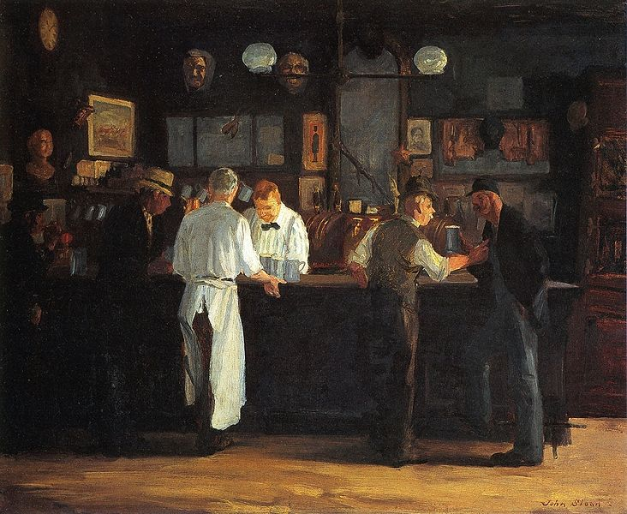
John Sloan
McSorley’s Bar
Oil on Canvas
1912
Notes:
Oldest Irish Bar in NYC, Men only until 1970!

Slide 42
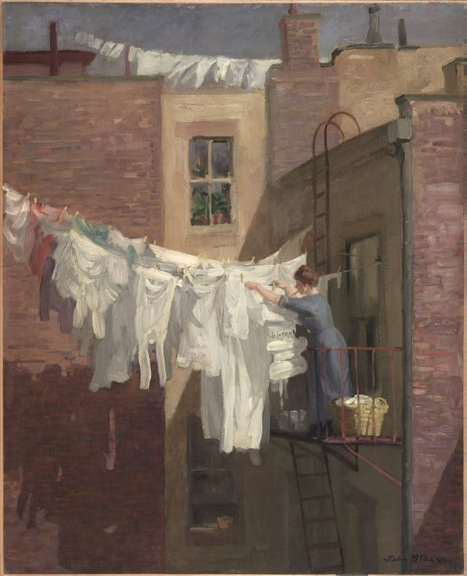
John Sloan
A Womans Work
Oil on Canvas
1912

Slide 43
George Bellows
1882-1905
From Columbus – went to OSU from 1901-1904 – played baseball and basketball
Chose painting over his career as a baseball player

Slide 44
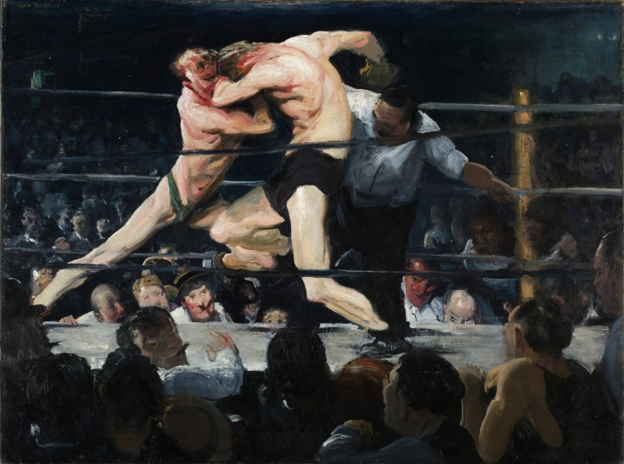
George Bellows
Stag at Sharkey’s
Oil on Canvas
1909
Notes:
Clubs, secret boxing matches

Slide 45
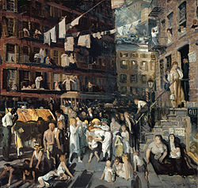
George Bellows
Cliff Dwellers
Oil on Canvas
1913
Notes:
Hot summer day in tennemant living
1870-1915 NYC population grows from 1.5 million to 5 million
Congestion and overpopulation

Slide 46
Edward Hopper
1882-1967
Worked as an illustrator
Great art is the outward expression of an inner life in the artist
Themes of lonliness

Slide 47
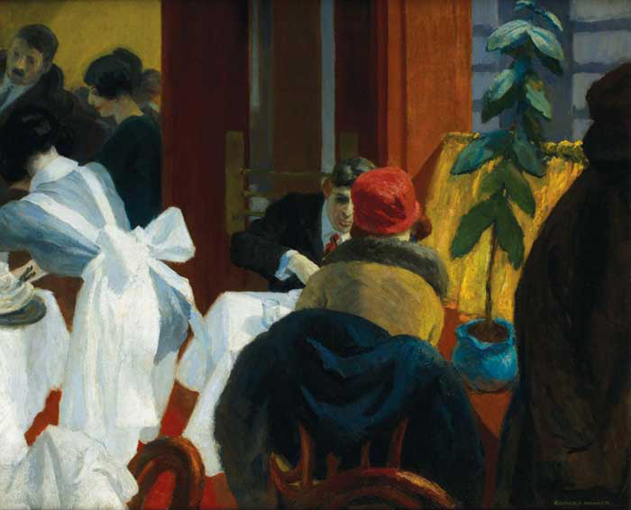
Edward Hopper
New York Restaurant
Oil on Canvas
1922
Notes:
a precise sense of location; clear, harsh light; strong geometric elements; and a sense of loneliness and melancholy.
While the scene is crowded, the woman in the red hat seems removed and distant, uninvolved with the man who sits with her.

Slide 48
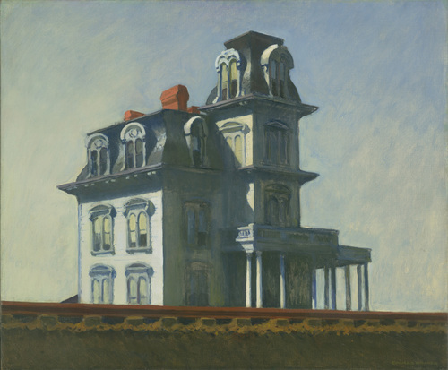
Edward Hopper
House by the Railroad
Oil on Canvas
1925
Notes:
a precise sense of location; clear, harsh light; strong geometric elements; and a sense of loneliness and melancholy.
While the scene is crowded, the woman in the red hat seems removed and distant, uninvolved with the man who sits with her.

Slide 49
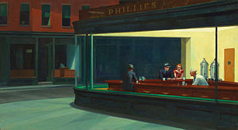
Edward Hopper
Nighhawks
Oil on Canvas
1942
Notes:
a precise sense of location; clear, harsh light; strong geometric elements; and a sense of loneliness and melancholy.
While the scene is crowded, the woman in the red hat seems removed and distant, uninvolved with the man who sits with her.

Slide 50
Social Realism
Draws attention to the everyday conditions of the working classes and the poor, and are critical of the social structures that maintain these conditions.

Slide 51
Journalism
Photography goes from documenting the world to documenting it for a cause

Slide 52
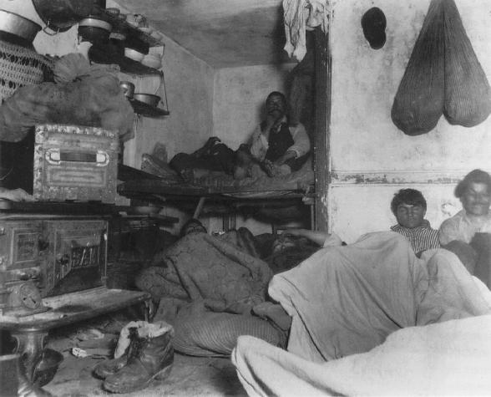
Jacob Riis
Five Cents Lodging
Photograph
1889

Slide 53
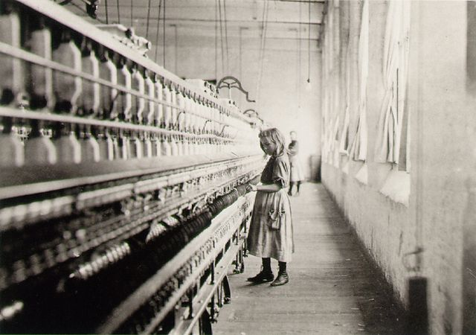
Lewis Hine
Girl Worker
Photograph
1908

Slide 54
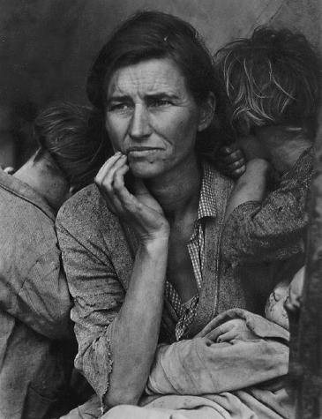
Dorthea Lange
Migrant Mother
Photograph
1936

