Slide 1
MODERNISM
We are finally here!

Slide 2
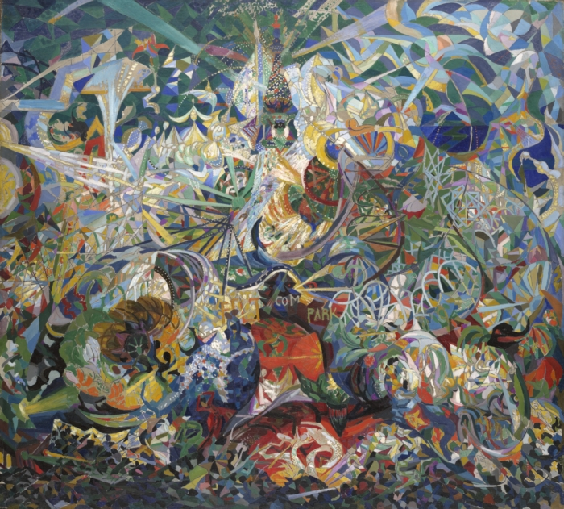
Joseph Stella
Battle of Lights, Coney Island, Mardi Gras
Oil on Canvas
1913-1914

Slide 3
MODERNISM 1900-1920’s
PUSHING THE BOUNDARIES FROM THE NORM!
Starts in Paris
The American public pose resistance to Modernism
Work is NOT recognized publically as ART

Slide 4
New York City
Hybrid of people and ideas
Desire to begin new cultures that are uniquely American
Art vs. Commercialism
New, fresh takes on ideas

Slide 5
Avant Garde Art
Experimental, innovative

Slide 6
So the public poses a new philosophical debate…
IS THIS ART??
What makes art “good” or “bad”?
Who’s opinion matters most?
WHAT DO YOU THINK???

Slide 7
Modernism has 3 major European influences:
FAUVISM
CUBISM
FUTURISM

Slide 8
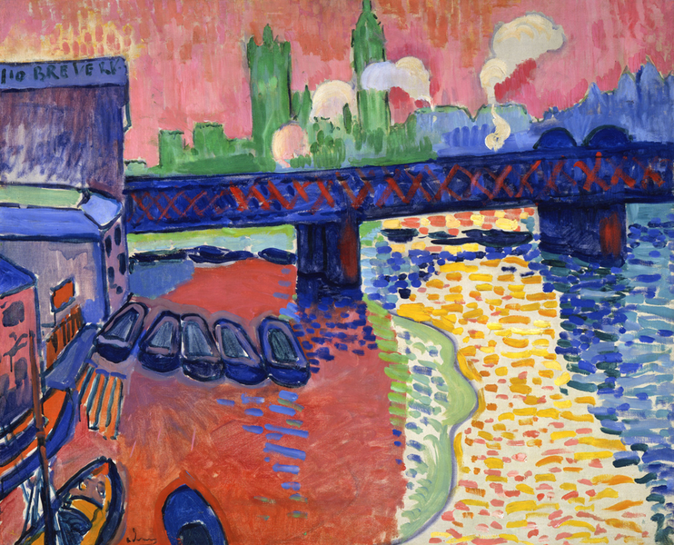
FAUVISM
“the wild beasts”
Painterly
Strong Color
Thick paint

Slide 9
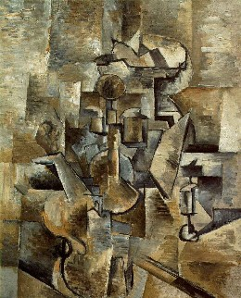
CUBISM
Objects are deconstructed and reconstructed
Multiple Viewpoints
Abstracting real objects

Slide 10
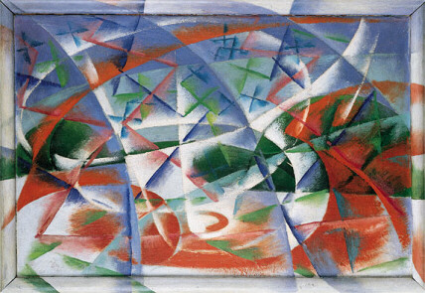
FUTURISM
Concepts of the FUTURE
Speed
Technology
Youth & Violence

Slide 11
Decide which art style fits the following American Artists…
FAUVISM?
CUBISM?
FUTURISM?

Slide 12
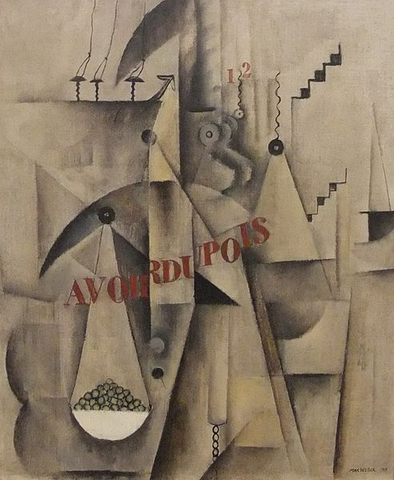
Max Weber
Avoirdupois
Oil on Canvas
1915

Slide 13
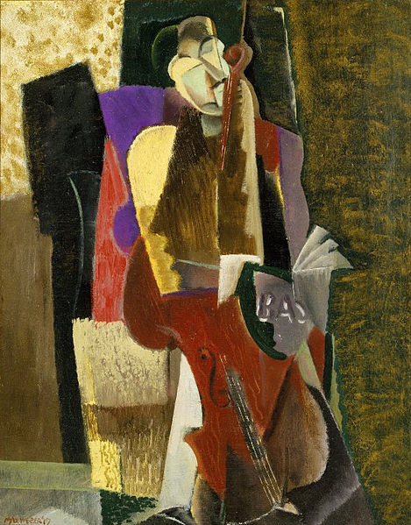
MAX WEBER 1881-1961
CUBISM
Brings Cubism to the US
Calls his work “kaleidoscopic still lifes”
Influenced by Picasso

Slide 14
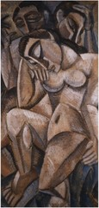
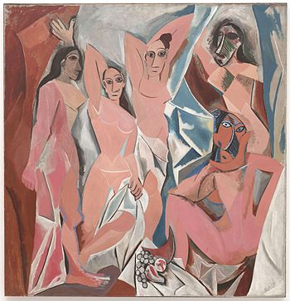
Weber – Composition with Three Figures, 1910
Picasso - Les Demoisselles d’Avignon, 1907

Slide 15
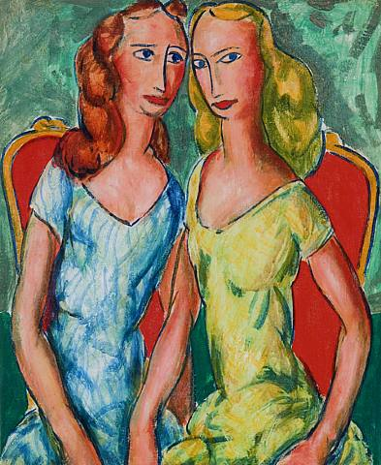
Alfred Henry Maurer
Two Sisters
Oil on Board
1924

Slide 16
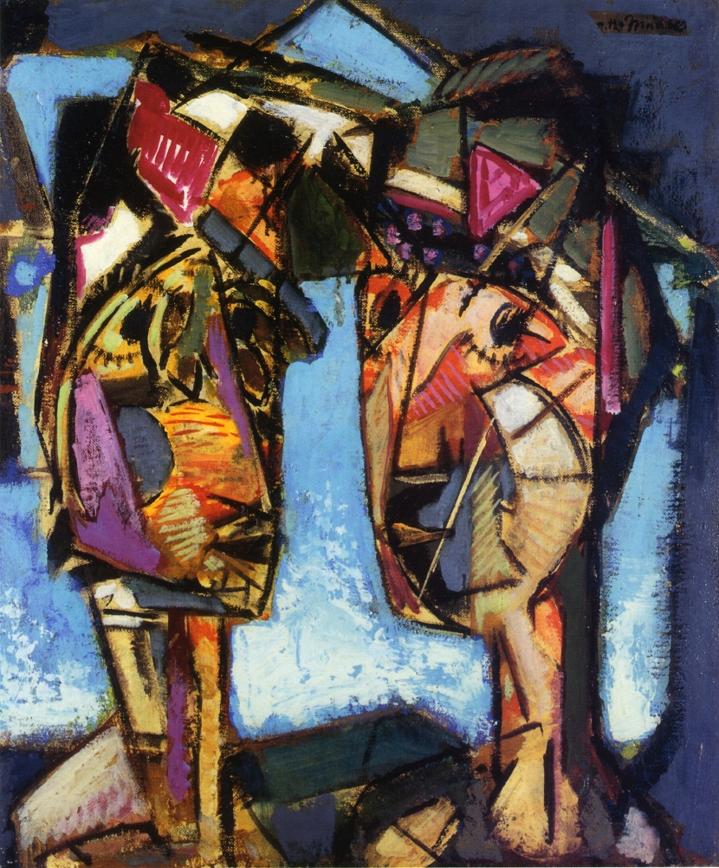
Alfred Henry Maurer 1868-1932
FAUVISM
Started off as a REALIST painter
FIRST AMERICAN MODERNIST

Slide 17
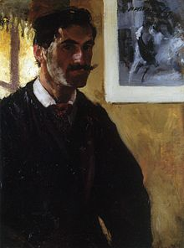
In the artists words…
"My main concern in painting is the beautiful arrangement of color values. For this reason, it is impossible to present an exact transcription of nature....It is necessary for art to differ from nature… The artist must be free to paint his effects. Nature must not bind him."
Notes:
What does this mean?

Slide 18
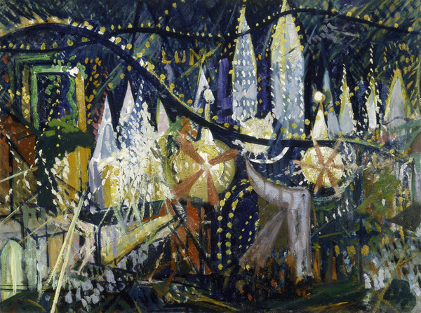
Joseph Stella
Luna Park
Oil on Board
1913

Slide 19
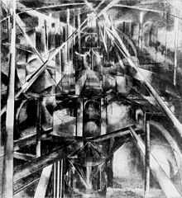
Joseph Stella 1877-1946
FUTURISM
FIRST AMERICAN FUTURIST
A true “avant-garde” artist
Best known for his depictions of INDUSTRIAL AMERICA
Brooklyn Bridge, Oil on Canvas, 1919-1920
Notes:
Brooklyn Bridge, Oil on Canvas, 1919-1920
Directional Energy
excitement and motion of modern life, I
n Stella’s hands the image of the Bridge also becomes a powerful icon of stability and solidarity.

Slide 20
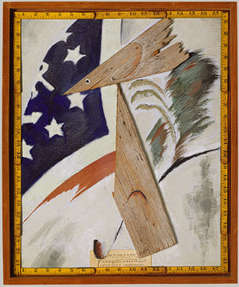
Arthur Dove
FIRST AMERICAN ABSTRACT PAINTER
Had the first public AMERICAN abstract art exhibition
Says his career was about “fighting for an idea”

Slide 21
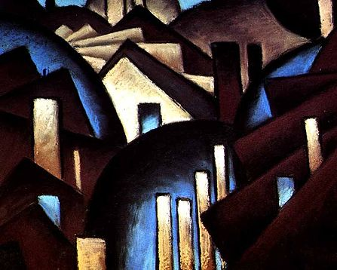
Emotions evoked by nature, spiritual
Arthur Dove
Nature Symbolized
Pastel on Board
1910

Slide 22
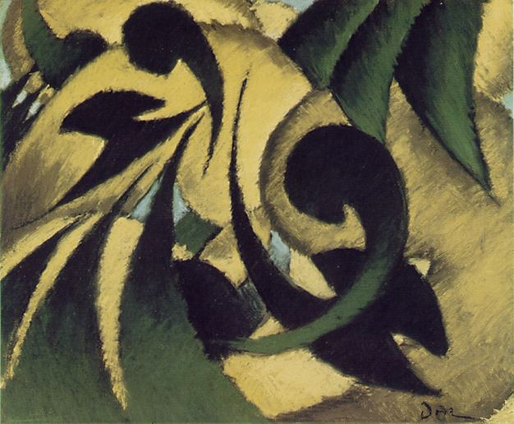
Think about this….
“I would like to make something that is real in itself, that does not remind anyone of any other thing, and that does not have to be explained”

Slide 23
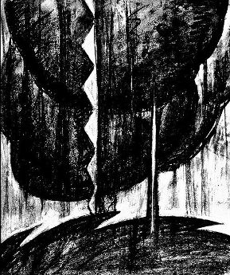
Arthur Dove
Thunderstorm
Print
1911-12

Slide 24
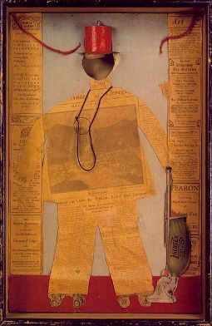
Arthur Dove
The Critic
Collage
1915

Slide 25
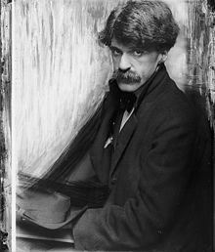
Gallery 291 & Alfred Stieglitz
Art Gallery in New York City
Alfred Stieglitz was the gallery manager
One of the first galleries to show photography as “art”
Introduces the US to Modernism and avant-garde art
Shows the work of Maurer, Dove, & Weber
His shows precede the famous “Armory Show”
Notes:
no other galleries in the United States were showing works with such abstract and dynamic content at that time.
“the gibberings of a lunatic”

Slide 26
Key Points
Modernism has three key European influences: Fauvism, Cubism and Futurism
Modernism challenges conventional thoughts on what makes art “good” or “bad”
Max Weber, Alfred Henry Mauer, Joseph Stella and Arthur Dove all contribute to the Modernism movement in America
Gallery 291 exposes the public to this new art form
Moving forward, modernism will increase in challenging the idea “What is art?” through the exhibition of “The Armory Show” in 1913

Slide 27
The Armory Show - 1913
First significant venue for Modernist Art in the US
Showcased the new avant-garde developments
Showed the art styles that were unfamiliar to a mainstream audience
Fauvism, Cubism and Futurism
HUGE – included 1,200 artworks by over 300 artists (both American and European) in 18 different gallery spaces
Notes:
Ashcan artists help organize the event

Slide 28
CONTROVERSIAL
People were intrigued and attending this show because of the hype of controversy!

Slide 29
The MOST Controversial Piece….

Slide 30
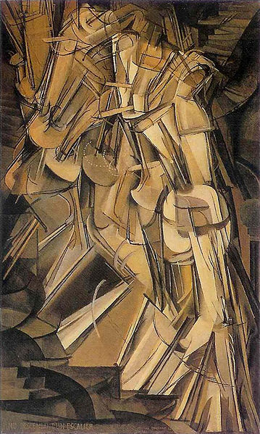
Marcel Duchamp
Nude Descending a Staircase
Oil on Canvas
1912

Slide 31
Why was this art controversial??
Viewers were puzzled – was there a nude?
Viewers were mad – why can’t I see it??
Viewers were outraged – is this a cultural step
backwards??

Slide 32
New York DADA - 1915, begins
French word meaning “hobby horse” (FOR NO REASON)
ANTI- RATIONAL, ABSURD
No distinct style
ARTISTIC ATTITUDE, DEFIES TRADITION
HUMOR is a main theme

Slide 33
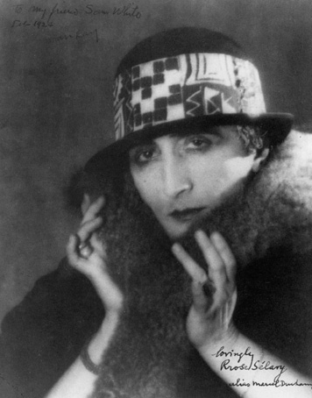
Marcel Duchamp – 1887-1968
Conceptual Artist
Idea behind the art is stronger or maybe more important than the art itself
Man Ray
Rose Sélavy
Photography
1921
Notes:
sounds like the French phrase "Eros, c'est la vie", which may be translated as "Eros, such is life". It has also been read as "arroser la vie" ("to make a toast to life").

Slide 34
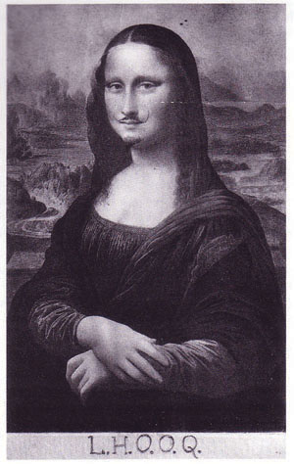
Readymades
Everyday objects and alterations declared “ART”
Marcel Duchamp
L.H.O.O.Q.
Ready-Made 1919
Notes:
poster-copy of the Mona Lisa with a moustache drawn on it
The name of the piece, L.H.O.O.Q. (in French èl ache o o qu), is a pun, since the letters when pronounced in French form the sentence "Elle a chaud au cul", which can be roughly translated as "Her ass is hot", or more accurately "She is really horny"

Slide 35
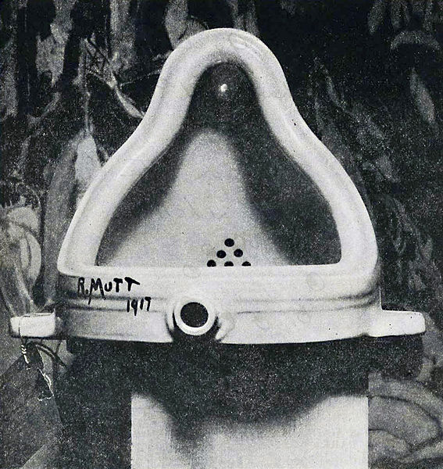
Marcel Duchamp
Fountain
Ready-Made Sculpture
1917

Slide 36
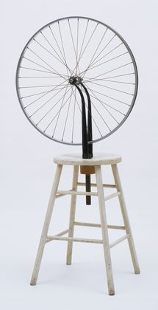
Marcel Duchamp
Bicycle Wheel
Ready-Made Sculpture
1913

Slide 37
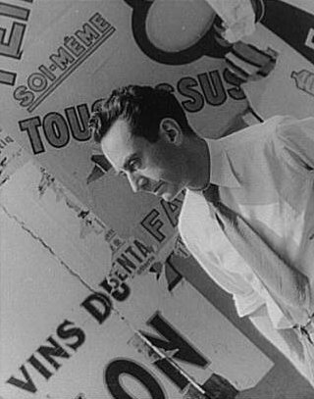
Man Ray 1890-1976
American Modernist
Highly influential in the US
Worked in a variety of media
Assemblage
Photography
Painting
Film

Slide 38
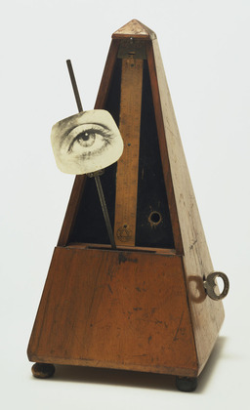
Man Ray
Indestructible Object or Object to be Destroyed
Assemblage
1923

Slide 39
Photography
Avant-Garde
“A camera alone does not make a picture. To make a picture, you need a camera, a photographer, and above all a subject. It is the subject alone that determines the interest of the photograph.” – Man Ray

Slide 40
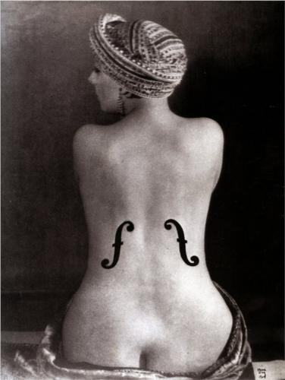
Man Ray
Ingre’s Violin
Photograph
1924

Slide 41
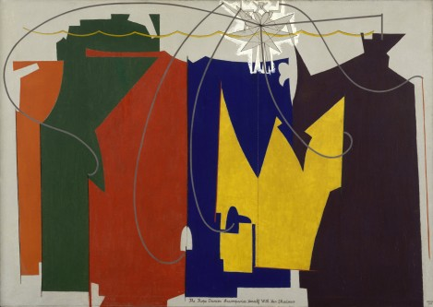
Man Ray
The Rope Dancer Accompanies Herself with her Shadows
Oil on Canvas
1924

Slide 42
Film
Artists begin using FILM as a MEDIA for ART
“The Love of Zero”
1928 Film by Robert Florey
“Two hearts, joined together in love but town apart by fate”

Slide 43
Key Points
The Armory Show was a HUGE controversial exhibition of Modernist art. It created a STIR because:
The art was NEW
The style was unfamiliar
The images and IDEAS behind the artwork were “abstract”
French/American Marcel Duchamp creates conceptual art such as “readymades” declaring everyday objects as art
Man Ray works in a variety of artforms and media including photography, assemblage and painting.
Both artists are pushing the envelope to ask the question: WHAT IS ART?

Slide 44
Review Questions
What does “avant garde” mean?
Describe FAUVISM. Who was the first American (fauvist) Modernist?
Define what it means to use “non-representational” color.
Describe CUBISM. Which American brings Cubism to the US?
Describe FUTURISM. Who is the first American Futurist?
Who is the first American Abstract painter?
How would you describe the philosophy behind the art movement “Modernism”?

Slide 45
Review Questions
What made the Armory Show of 1913 Controversial?
What French/American artist creates readymades?
Describe readymade art.
Who was the American modernist that worked in a variety of media and artforms?
What is an art media?
What is an art form?
What makes an artwork good? Who decides if it is good?

